Slide 1


Automated feedback processing in the educational process
National Technical University of Ukraine “Kyiv Polytechnic Institute”
Heat and Power Engineering Department
Automation of Design of Energy Processes and Systems
Presented by Maxym Storozhenko
2nd grade student, group TM-41m
Academic adviser I. Mykhailova
VІI scientific and practical seminar with international participation
"Economic security of the state and scientific and technological aspects of its provision"
October 21-22, 2015, Kyiv, Ukraine

Slide 2
Functionality
Filling in all pertaining information about the teaching process, including a list of courses, groups, studying years etc.
Creating a questionnaire about a course material or course structure.
Giving students and teachers access to created questionnaires so that they will be able to answer the questions.
Processing questionnaires filled in by students and teachers and creating statistics about most common comments and suggestions.
Registering comments on how to improve course materials or course structure so that both students and teachers will be more satisfied with their work.
Creating a final report on the student and teacher satisfaction.

Slide 3
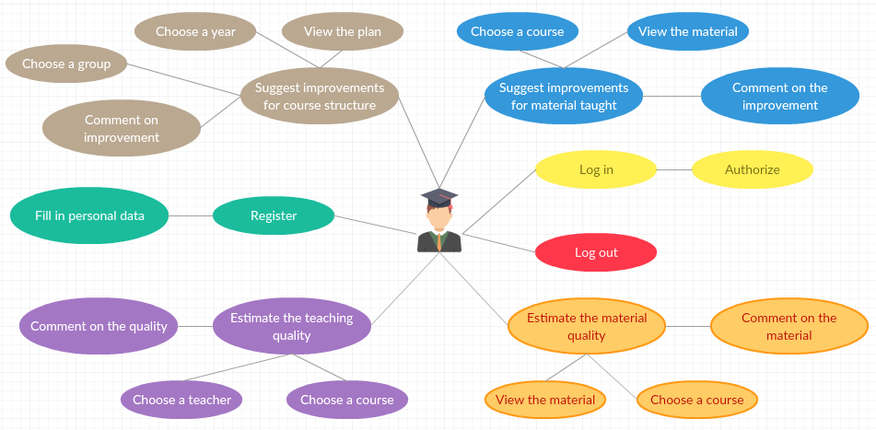
Use case diagram (from the point of view of a student)

Slide 4
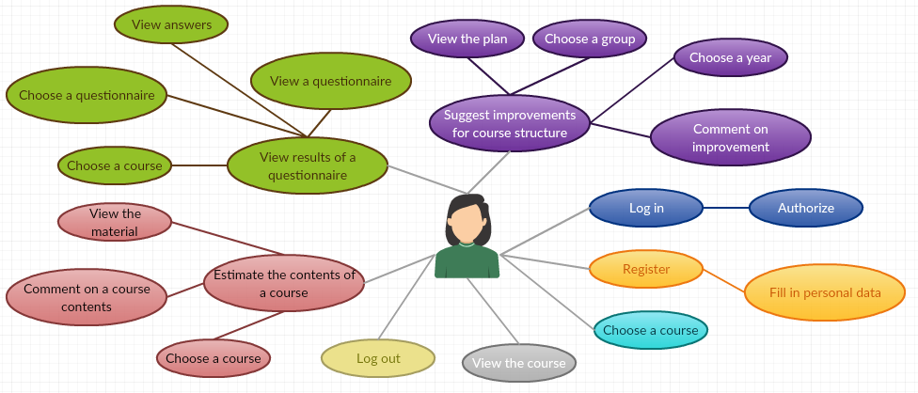
Use case diagram (from the point of view of teacher)

Slide 5
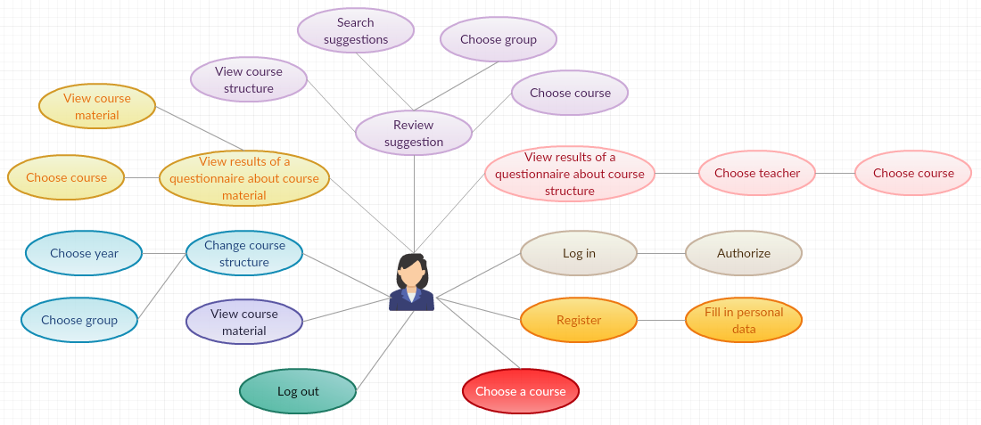
Use case diagram (from the point of view of university official)

Slide 6
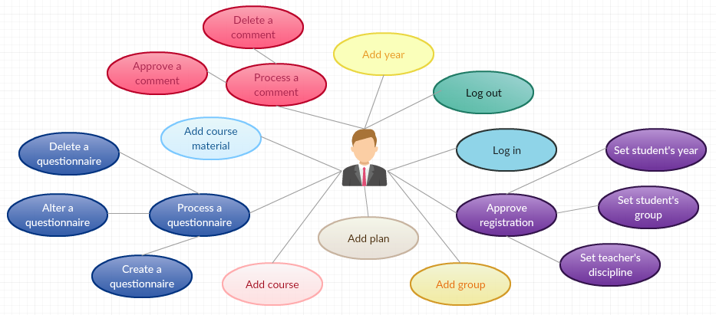
Use case diagram (from the point of view of system administrator)

Slide 7






Used products, technologies and frameworks

Slide 8
Sources
http://www.intersystems.com
http://www.restapitutorial.com
http://www.json.org
https://angularjs.org
https://nodejs.org/en

Slide 9
Thank you for your attention!

