Slide 1


Quick search in documents stored in DBMS InterSystems Caché using IndexTank API
National Technical University of Ukraine “Kyiv Polytechnic Institute”
Heat and Power Engineering Department
Automation of Design of Energy Processes and Systems
VІI scientific and practical seminar with international participation
"Economic security of the state and scientific and technological aspects of its provision"
October 21-22, 2015, Kyiv, Ukraine
Presented by Iryna Mykhailova
Technical adviser Oleksandr Pampushko

Slide 2
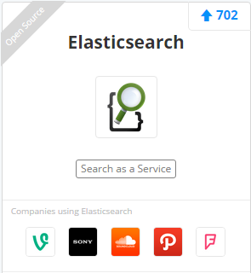
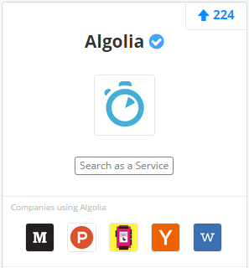
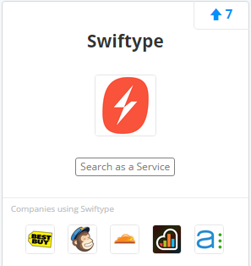
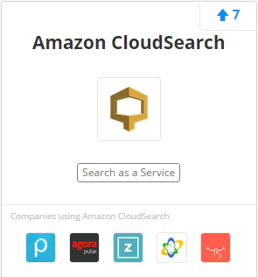
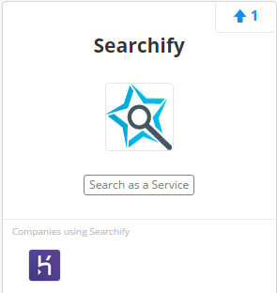
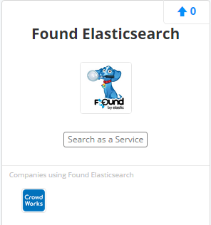
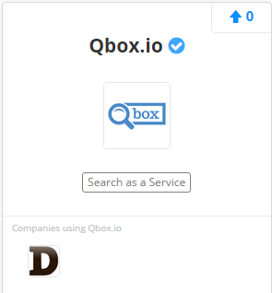
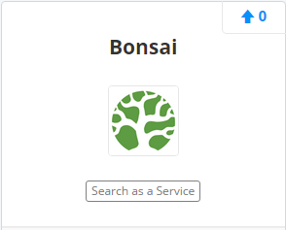
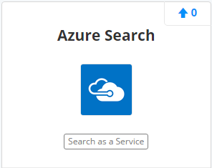
Search-as-a-Service
*
* According to stackshare.io/search-as-a-service

Slide 3
Document search engines with real-time updates
Based of IndexTank API
IndexDen www.indexden.com/
Searchify www.searchify.com/
Not based on IndexTank API
Blekko www.blekko.com/
ElasticSearch www.elasticsearch.com/
SearchBlox www.searchblox.com/
Sphinx Search www.sphinxsearch.com/
Spinn3r www.spinn3r.com/
Websolr www.websolr.com/

Slide 4
What is IndexTank?
IndexEngine: a real-time fulltext search-and-indexing system designed to separate relevance signals from document text. This is because the life cycle of these signals is different from the text itself, especially in the context of user-generated social inputs (shares, likes, +1, RTs).
API: a RESTful interface that handles authentication, validation, and communication with the IndexEngine(s). It allows users of IndexTank to access the service from different technology platforms (Java, Python, .NET, Ruby and PHP clients are already developed) via HTTP.
Nebulizer: a multitenant framework to host and manage an unlimited number of indexes running over a layer of Infrastructure-as-a-Service. This component of IndexTank will instantiate new virtual instances as needed, move indexes as they need more resources, and try to be reasonably efficient about it.

Slide 5
Features of IndexTank
Real-time search
  Real-time indexing – results immediately available
  Index multiple documents simultaneously
  Overwriting existing documents – changes immediately available
Custom scoring and sorting
  Programmer chooses how results are returned
  Pre-written scoring functions available
  Programmer may write his own scoring functions
Autocomplete
Has OpenSource API

Slide 6
Features of IndexTank (continuation)
Faceting
  Allows you to categorize documents in the index
  Truncates irrelevant results
Geo search
  Has built-in geo proximity search and filtering capability
  Works with the GPS of the current device (if available)
Advanced text search
  Supports fuzzy search (Did you mean..?)
  Supports stemming (tense, possession, etc…)
  Provides alternate spellings
  Supports misspellings

Slide 7
What is InterSystems Caché?
InterSystems Caché® is an advanced database management system and rapid application development environment. With Caché, you’ll make breakthroughs in processing and analyzing complex Big Data, and developing Web and mobile applications. Caché uniquely offers lightning-fast performance, massive scalability, and robust reliability – with minimal maintenance and hardware requirements.
This is a new generation of database technology that provides multiple modes of data access. Data is only described once in a single integrated data dictionary and is instantly available using object access, high-performance SQL, and powerful multidimensional access – all of which can simultaneously access the same data.
Caché comes with several built-in scripting languages, and is compatible with the most popular development tools.

Slide 8
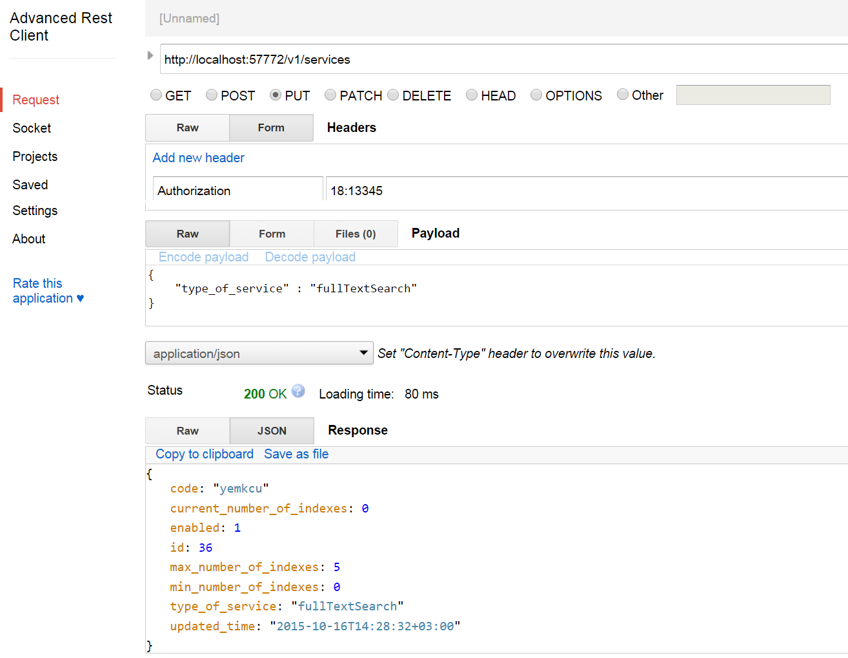
Implementation of IndexTank API in Caché
(Creating service – JSON query and answer)

Slide 9
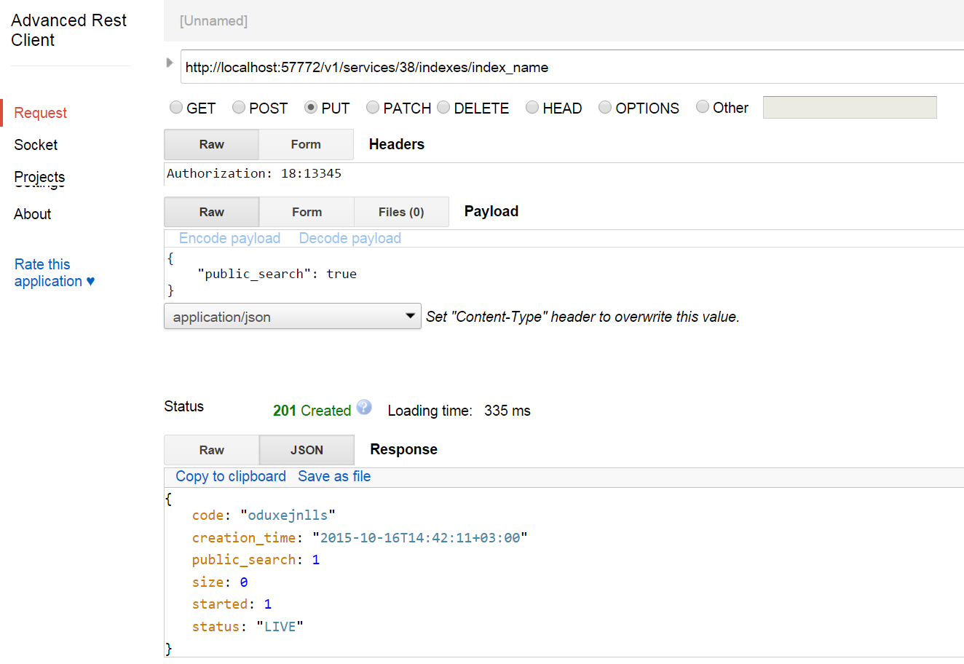
Implementation of IndexTank API in Caché
(Creating index – JSON query and answer)

Slide 10
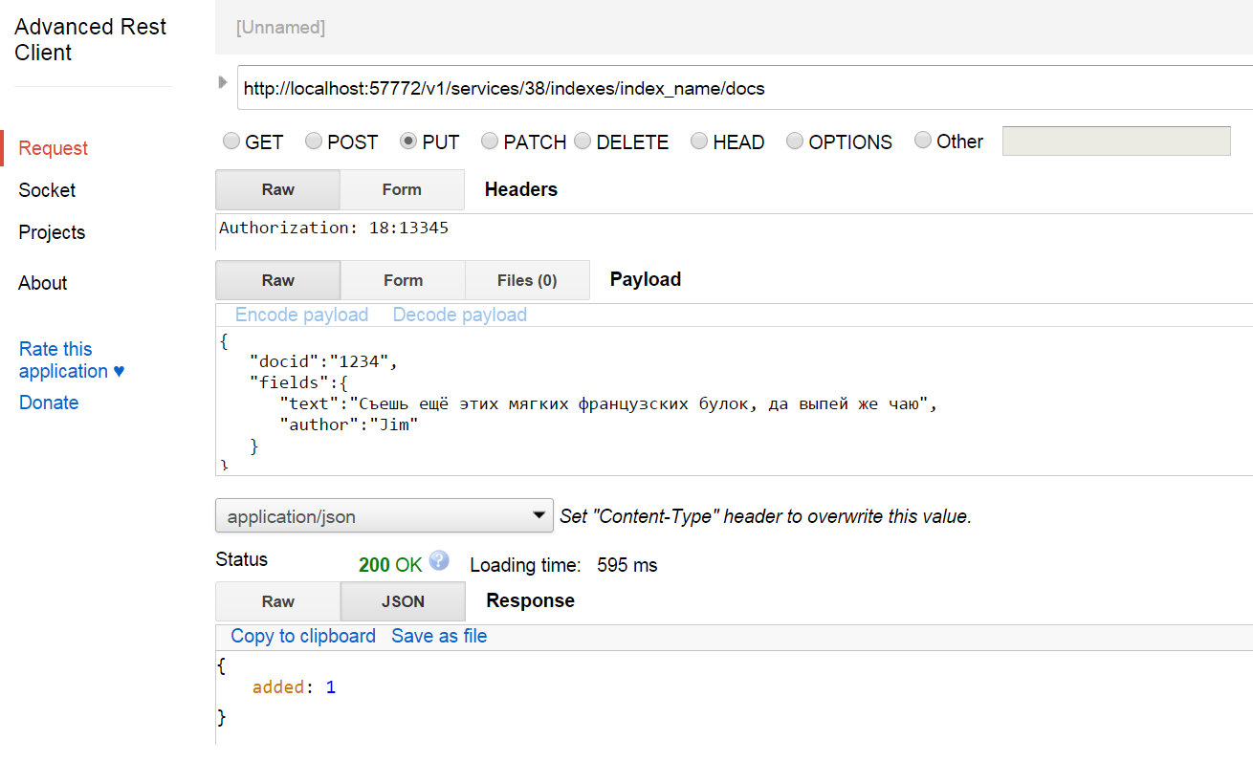
Implementation of IndexTank API in Caché
(Adding document – JSON query and answer)

Slide 11
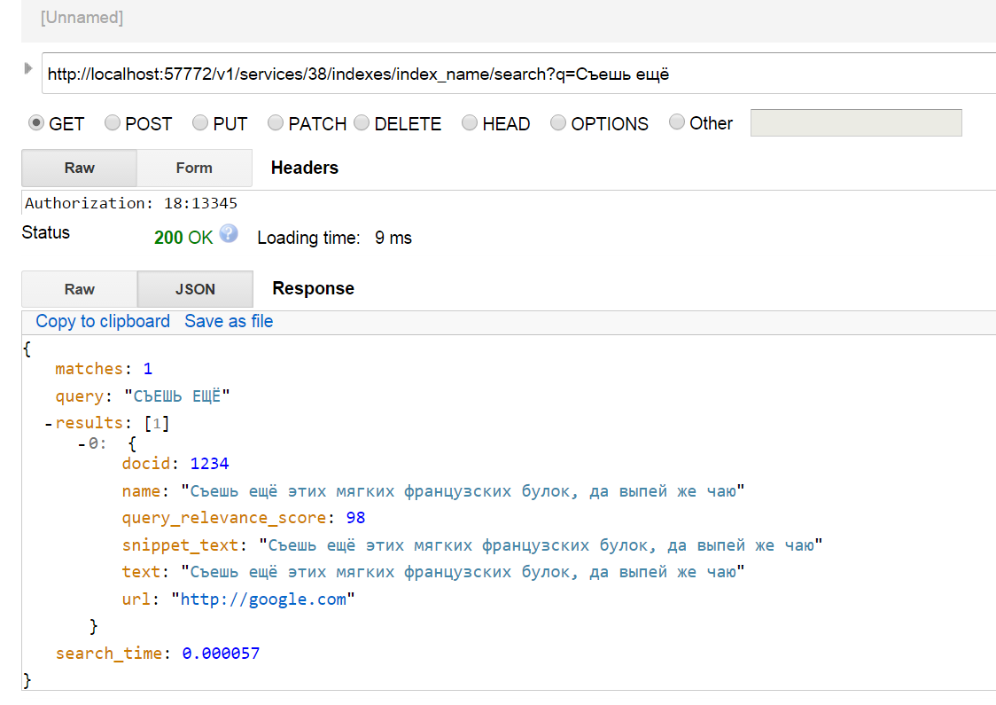
Implementation of IndexTank API in Caché
(Searching documents – JSON query and answer)

Slide 12
Sources
http://www.searchify.com/
https://engineering.linkedin.com/open-source/indextank-now-open-source
http://habrahabr.ru/post/141820/
http://www.intersystems.com/our-products/cache/cache-overview/
https://github.com/linkedin/indextank-engine
http://www.slideshare.net/YogiWanKenobi/finding-anything-realtime-search-with-indextank
http://www.searchify.com/documentation/api
http://www.intersystems.com/our-products/cache/tech-guide/chapter-2/

Slide 13
Thank you for your attention!

