Slide 1


A POWER OF OLAP TECHNOLOGY
National Technical University of Ukraine “Kiev Polytechnic Institute”
Heat and energy design faculty
Department of automation design of energy processes and systems (ADEPS)
VІI scientific and practical seminar with international participation
“Economic security of the state and scientific and technological aspects of its provision".
October 21-22, 2015, Kyiv, Ukraine
Student of 4th department
Group Tm-21
Valeriya Bohdan
Scientific Director
Karaieva N.V.

Slide 2

What is OLAP?
OLAP (Online Analytical Processing) is a category of software tools that provides analysis of data stored in a database. OLAP tools enable users to analyze different dimensions of multidimensional data.
OLAP is a powerful technology for data discovery, including capabilities for limitless report viewing, complex analytical calculations, and predictive “what if” scenario (budget, forecast) planning.
VІI scientific and practical seminar with international participation"Economic security of the state and scientific and technological aspects of its provision".

Slide 3
How is OLAP Technology Used?
OLAP enables end-users to perform ad hoc analysis of data in multiple dimensions, thereby providing the insight and understanding they need for better decision making. It is the foundation for many kinds of applications for
Business Performance Management,
Planning,
Budgeting,
Forecasting,
Financial Reporting,
Analysis,
Simulation Models,
Knowledge Discovery,
Data Warehouse Reporting.
VІI scientific and practical seminar with international participation"Economic security of the state and scientific and technological aspects of its provision".

Slide 4
Main types of OLAP
Name of type | Advantages | Disadvantages
MOLAP (multi-dimensional online analytical processing) | •Fast query performance Smaller on-disk size of data •Automated computation of higher level aggregates of the data. •It is very compact for low dimension data sets. | •Limited amount of data •Some MOLAP methodologies introduce data redundancy.
ROLAP (relational online analytical processing) | •Unlimited input data | •Processing step (data load) is quite lengthy.
HOLAP (hybrid online analytical processing) | •allowing to use trade off of the advantages of MOLAP and ROLAP | •HOLAP evince the the weaknesses of MOLAP, ROLAP
VІI scientific and practical seminar with international participation"Economic security of the state and scientific and technological aspects of its provision".

Slide 5
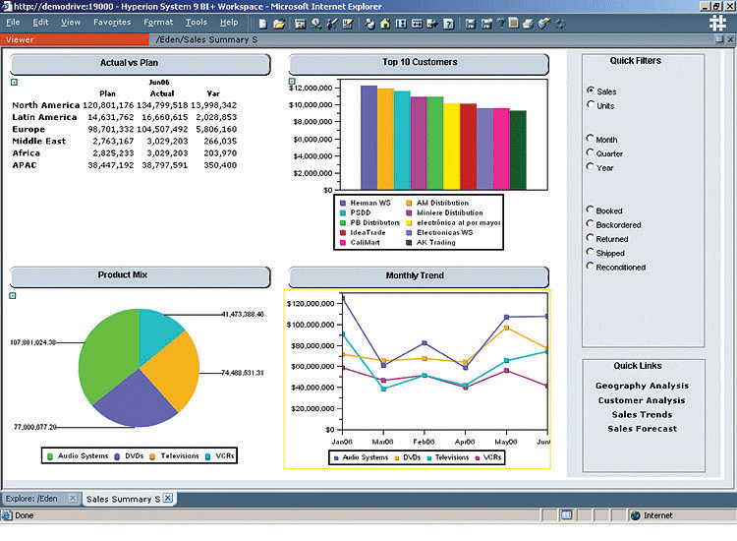
Example of OLAP features
VІI scientific and practical seminar with international participation"Economic security of the state and scientific and technological aspects of its provision".

Slide 6
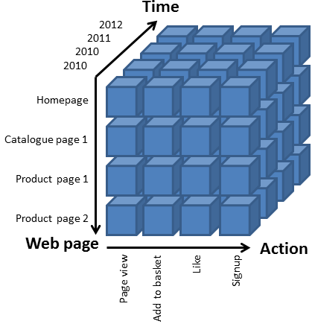
OLAP cube
A cube can be considered a multi-dimensional generalization of a two- or three-dimensional spreadsheet
OLAP consists of three basic analytical operations: consolidation (roll-up), drill-down, and slicing and dicing.
VІI scientific and practical seminar with international participation"Economic security of the state and scientific and technological aspects of its provision".

Slide 7
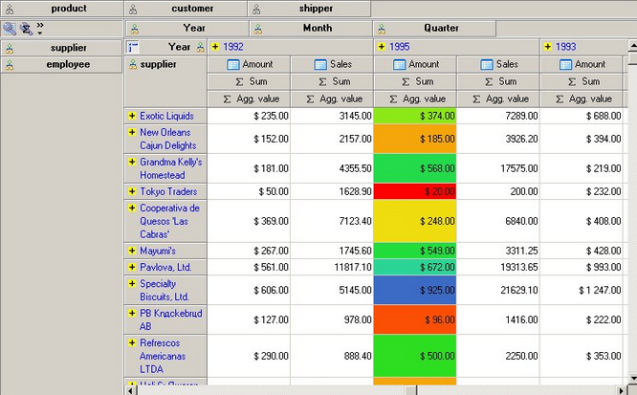
OLAP slicing
Slice is the act of picking a rectangular subset of a cube by choosing a single value for one of its dimensions, creating a new cube with one fewer dimension.
VІI scientific and practical seminar with international participation"Economic security of the state and scientific and technological aspects of its provision".

Slide 8
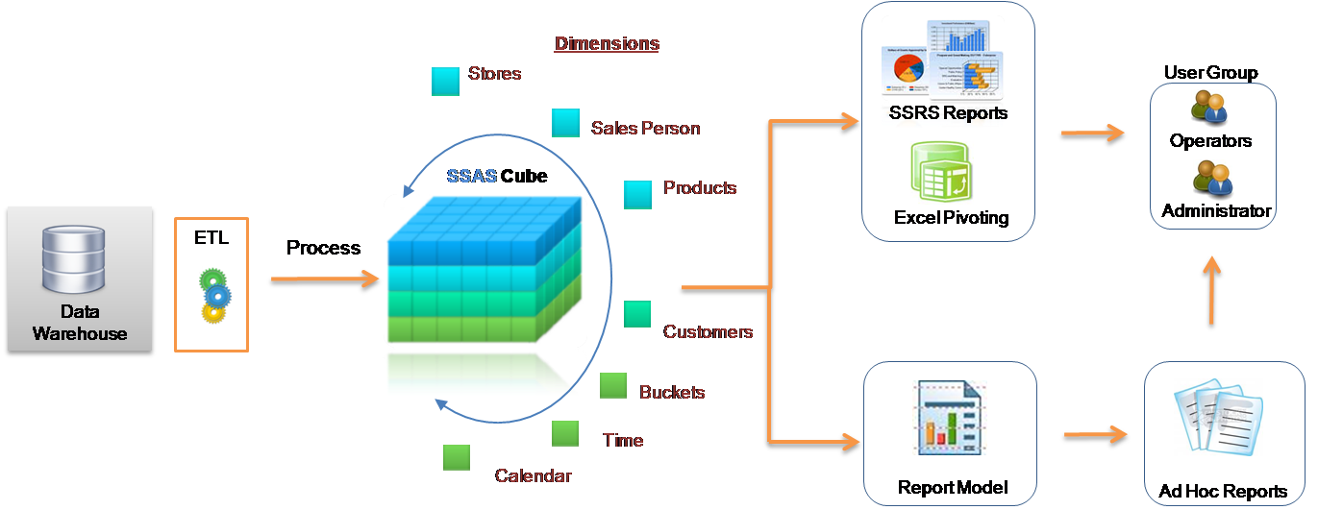
OLAP functionalities
Pivot allows an analyst to rotate the cube in space to see its various faces. For example, cities could be arranged vertically and products horizontally while viewing data for a particular quarter
Drill Down/Up allows the user to navigate among levels of data ranging from the most summarized (up) to the most detailed (down).

Slide 9
Thanks for your attention
VІI scientific and practical seminar with international participation"Economic security of the state and scientific and technological aspects of its provision".

