Slide 1


National Technical University of Ukraine “Kiev Polytechnic Institute”
Heat and energy design faculty
Department of automation design of energy processes and systems (ADEPS)
Methods and Tools for predicting the state of Ukraine`s regions in terms of economic safety
VІI scientific and practical seminar with international participation
“Economic security of the state and scientific and technological aspects of its provision".
October 21-22, 2015, Kyiv, Ukraine
Student of 4th department
Group TM-21
Olena Pidberezna
olenapidberezna16@gmail.com
Scientific Director
Karaieva N.V.

Slide 2
Methods of predicting
Scientists estimated that there are over 150 different methods of predicting, but in practice only two or three dozen are used.
To choose the method of prediction you should determine:
purpose;
problems of prediction;
period for which it is formed;
take account of the specificity of the prediction`s object;
species, completeness and reliability of input data;
other factors.
VІI scientific and practical seminar with international participation
"Economic security of the state and scientific and technological aspects of its provision"

Slide 3
Methods of predicting the general principle of action and ways to get information
Methods of analysis and prediction of the degree of formalization
Intuitive
(qualitative)
Individual expert estimates
Interview
Questionnaires
Self-reported
Policy briefing
Collective expert estimations
The method of commissions
The method of "Delphi"
Matrix method
Formal
(quantitative)
The methods of extrapolating trends
The usual extrapolation
All times trend
The method of autoregression
The method of of exponential smoothing
Simulation methods
Structured
Imitating
Networking
Statistics
Based on the regression equation
Based on the system of regression equations
VІI scientific and practical seminar with international participation
"Economic security of the state and scientific and technological aspects of its provision"

Slide 4
Quality evaluation
Qualitative assessment of connection degree of random variables can be performed using the correlation coefficient of the Cheddok`s scale.
Cheddok`s scale
Value of the coefficient of correlation | Connection
[-0,1...0,1) | feedback
[0,1...0,3) | slight
[0,3...0,5) | moderate
[0,5...0,7) | significant
[0,7...0,9) | high
[0,9...0,99] | very high
1,0 | functional
VІI scientific and practical seminar with international participation
"Economic security of the state and scientific and technological aspects of its provision"

Slide 5
Methods of cluster analysis
Algorithms of Optimization: k-means; PAM; CLOPE; HCM (HardC-means); FuzzyC-means; Kohonen self-organizing maps and others.
Non-hierarchical
Methods of cluster analysis
Hierarchical
Agglomerative
Divisive
Algorithms of combining: CURE
The methods of grouping: method of nearest neighbor or a single bond; method of the most distant neighbors or full bond; Ward`s method; unweighted average pairwise method; method of inter-group communication.
Algorithms of division:
- algorithm of BIRCH
- algorithm of MST
-
VІI scientific and practical seminar with international participation
"Economic security of the state and scientific and technological aspects of its provision"

Slide 6
The value of selected ecological and economic indicators of development of Ukraine`s regions (2012 year)
Region | Indicators
 | GRP (million UAH) | EP (million kg) | SP (million UAH) | IP (million UAH) | I (million USD) | E (million USD)
Kiev | 69663,00 | 308,1 | 227722,60 | 55941,00 | 1982,97 | 4793,23
Donetsk | 170775,00 | 1714,7 | 664615,90 | 158003,00 | 14127,18 | 4168,47
Dnipropetrovsk | 147970,00 | 1173,1 | 447705,40 | 118823,00 | 10129,72 | 6538,26
… | … | … | … | … | … | …
Zaporizhia | 54828,00 | 316 | 124278,20 | 59191,00 | 4004,80 | 2013,43
Lviv | 61962,00 | 253,9 | 131984,60 | 72828,00 | 1343,54 | 3373,48
Odessa | 64743,00 | 169 | 141059,40 | 70429,00 | 1784,64 | 4304,58
Kiev city | 275685,00 | 259,2 | 1378512,30 | 194436,00 | 12770,31 | 26115,99
GRP - gross regional product
EP - emissions of pollutants into the atmosphere
SP - the volume of sold products
IP - income of population
I - import
E - export

Slide 7
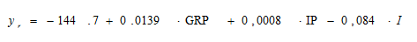
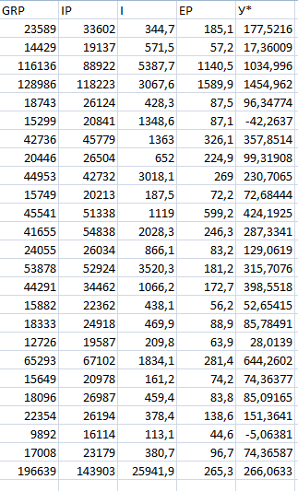
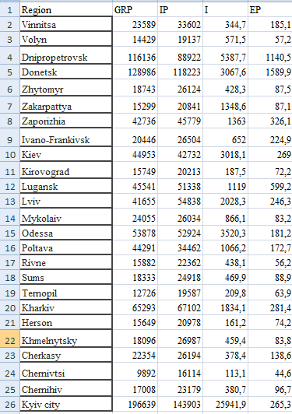
Regression analysis
The regression equation will look like:
According to the indicators that
remained after the multicollinear analysis,
in the table, we can predict
values of EP. It is Y*
(for 25 regions of Ukraine).

Slide 8
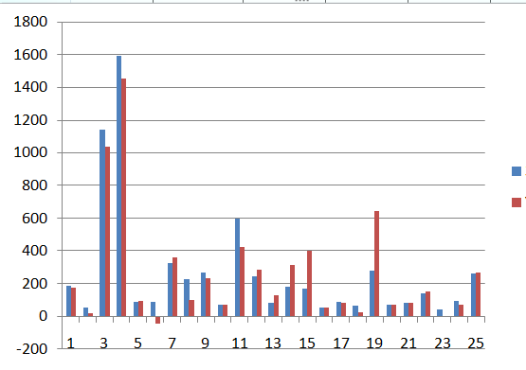
Chart
emissions of pollutants into the atmosphere
(million kg)
predictable value
number of Ukraine`s regions
VІI scientific and practical seminar with international participation
"Economic security of the state and scientific and technological aspects of its provision"

Slide 9

Software tools
At present there are many software tools developed for the implementation of diverse analysis of economic security. Each of them has different specialization and is intended for processing components of analysis process:
software packages for statistical data processing;
software for assessing the
environmental parameters of
economic activity;
software for the analysis of safety
engineering systems;
software packages to assess the
financial parameters of enterprises;
geoinformational data processing
with the using of GIS technology;
VІI scientific and practical seminar with international participation
"Economic security of the state and scientific and technological aspects of its provision"

Slide 10

The most famous foreign packages for statistical data processing
BMDP, STATGRAPHICS, SAS, SPSS, E.Views, RATS, MikroTSP, Minitab, STADIA, SYSTAT, MEZOZAVR, EVRISTA
The basic functions of these software packages are:
business graphics;
parametric tests (Student’s t test, Fisher’s test, histogram);
nonparametric tests;
categorical analysis;
dispersion analysis (single, double, multi);
regression analysis;
time series (smoothing, filtering, autocorrelation);
multivariate methods;
VІI scientific and practical seminar with international participation
"Economic security of the state and scientific and technological aspects of its provision"

Slide 11

Software packages for the valuation of financial options of enterprise
COMFAR, Project Expert, "Alt-INVEST", "INEC-Holding", "Theo-INVEST", Energy Invest, "Іnvestor-PL", Millenium, "ALT-Fіnansi", "AFSP", "AuditExpert“
which are classical approaches to financial analysis
VІI scientific and practical seminar with international participation
"Economic security of the state and scientific and technological aspects of its provision"

Slide 12
Means for making geoinformation analysis
COMPARATIVE DATA | ARCGIS | GRASSGIS | MAPINFO | GVSIG
OPENNESS | - | + | + | -
WORK WITH THE DB | + | + | + | -
OPTIMIZATION for working with SQL-server | + | + | + | -
FRONTEND | ODE, API ActiveX, COM, AML | API ActiveX, ODBC, BDE | BDE, OLE DB, API | API ActiveX
The ability to create their own modules | + | - | + | -
TYPES OF GIS
Tool GIS
PC Arc/Info, PC ArcCad, MapInfo, ArcGIS
GIS Viewers
ArcView, GisView, GeoDraw
Help mapping system
BY-Sell, ИНТЕК-2, WireMap
Vectorizer raster images
MapEdit, TRACK, AURE, CorelDraw
Specialized tools of spatial modeling
Geostatistical Software Tool V3.03, MAG Software
VІI scientific and practical seminar with international participation
"Economic security of the state and scientific and technological aspects of its provision"

Slide 13
Thanks for your attention!
VІI scientific and practical seminar with international participation
"Economic security of the state and scientific and technological aspects of its provision"

