Slide 1


National Technical University of Ukraine “Kiev Polytechnic Institute”
Heat and energy design faculty
Department of automation design of energy processes and systems (ADEPS)
MODELS AND METHODS OF REPRESENTATION TEXT DOCUMENTS IN THE INFORMATION RETRIEVAL SYSTEMS
VІI scientific and practical seminar with international participation
“Economic security of the state and scientific and technological aspects of its provision"
October 21-22, 2015, Kyiv, Ukraine
Student of 6th department
Group TI-41m Nataliia Pliiashko

Slide 2
The Purpose of Information Retrieval (IR)
Find all documents relevant for a user query in a collection of documents
Collect and organize information in one ore more subject area
Retrieve relevant document before non-relevant document
Provide users with those documents that will satisfy their information need

Slide 3
The Tasks of Information Retrieval
Classic information retrieval
Ad-hoc retrieval (querying) – pull technology
Interactive query formulation
Automatic document clustering, rubricating and filtering
Text mining

Slide 4
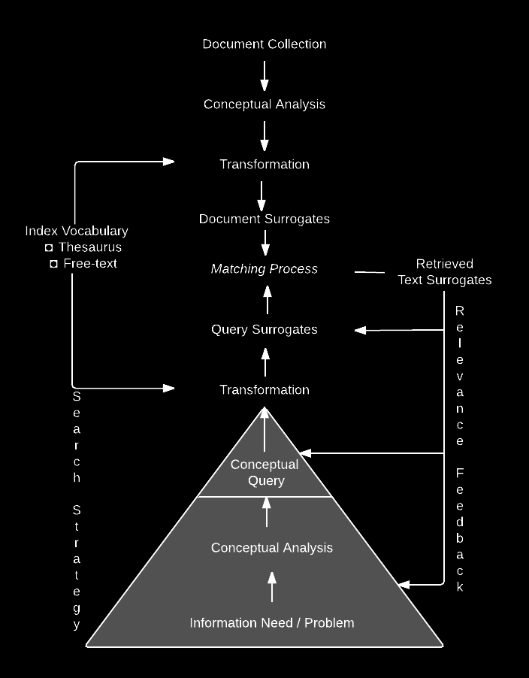
The Information Representation and Retrieval Process
The information need can be understood as forming a pyramid, where only its peak is made visible by users in the form of a conceptual query.
In the information retrieval process both the user's information need and the document collection have to be translated into the form of surrogates to enable the matching process to be performed.

Slide 5
The Models and Methods of Information Retrieval
MODELS
Boolean model
Statistical model
Vector space model
Probabilistic retrieval model
Linguistic model
Knowledge-based model
TF-IDF
METHODS
Linguistic analysis
Lexical analysis
Morphological analysis
Semantic analysis
Syntactic analysis (parsing)
Statistical analysis
Latent semantic analysis

Slide 6
The Social Value
The solution of problems analysis documents is an actual and demanded, not only in the field of information retrieval systems, but also in the system of processing and analyzing information. This wide range of intelligent information processing tasks, including the tasks of retrieving, and identifying the semantic content of the speech recognition. All this causes the relevance and importance of research in the field of analysis and processing of unstructured information.
Researches the effect of the choice of the model and its various characteristics on the quality of information retrieval allows to design and implement information systems more efficient methods and algorithms for computing the semistructured data.

Slide 7
Thanks For Your Attention

