Slide 1


WHAT IS 3D PRINTING?
National Technical University of Ukraine “Kiev Polytechnic Institute”
Heat and energy design faculty
Department of automation design of energy processes and systems (ADEPS)
VІI scientific and practical seminar with international participation
“Economic security of the state and scientific and technological aspects of its provision".
October 21-22, 2015, Kyiv, Ukraine
Student of 4th department
Group TM-21 Valeriya Bohdan
Scientific Director
Varava I.

Slide 2
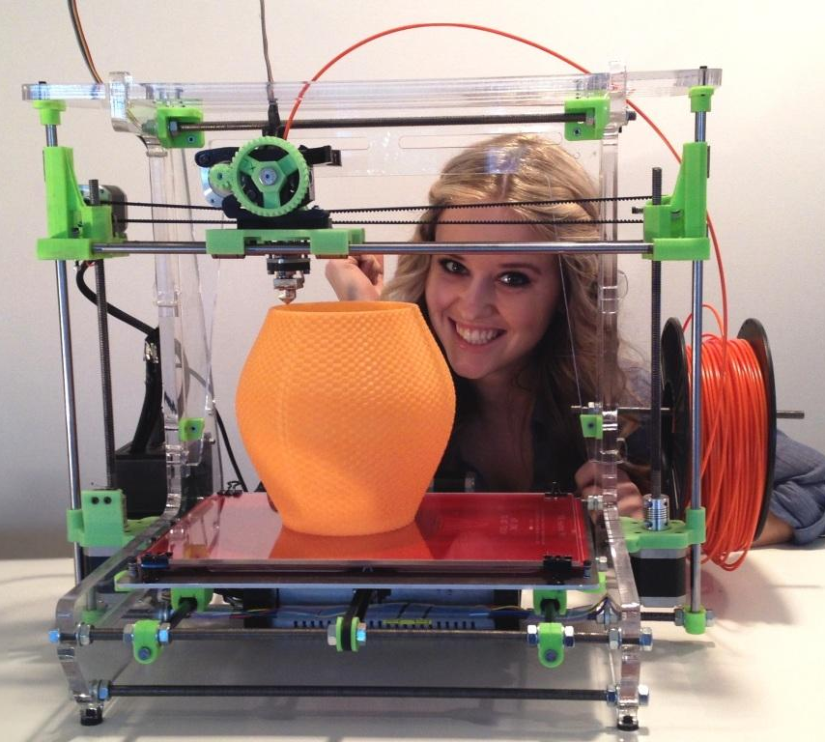
What is 3D printing?
3D printing is a process of making three dimensional solid objects from a digital file.
These objects can be of almost any shape, and are produced from a 3D model or other electronic data source
VІI scientific and practical seminar with international participation
"Economic security of the state and scientific and technological aspects of its provision"

Slide 3
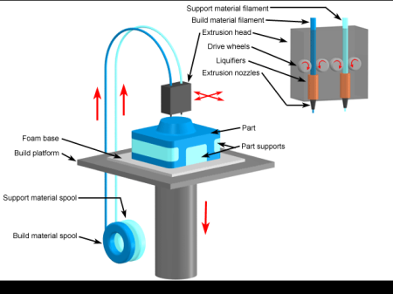
How does 3D printing work?
An object is created by laying down successive layers of material until the entire object is created.
Each of these layers can be seen as a thinly sliced horizontal cross-section of the eventual object.
VІI scientific and practical seminar with international participation
"Economic security of the state and scientific and technological aspects of its provision"

Slide 4
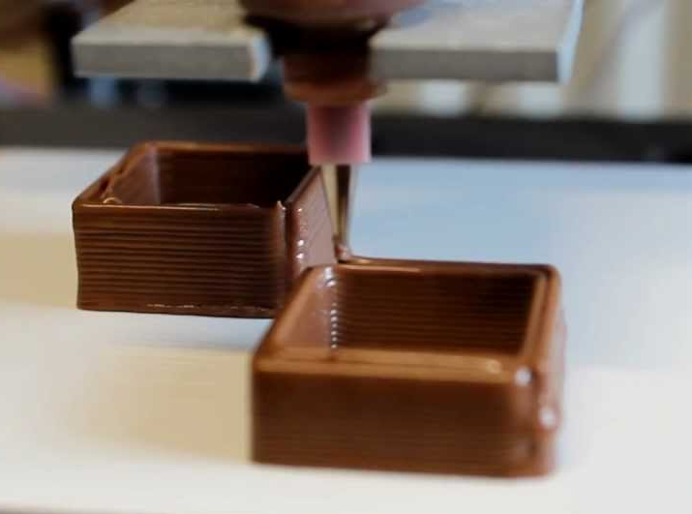
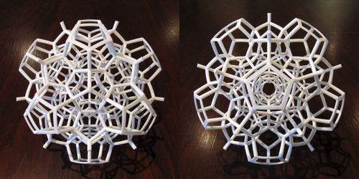
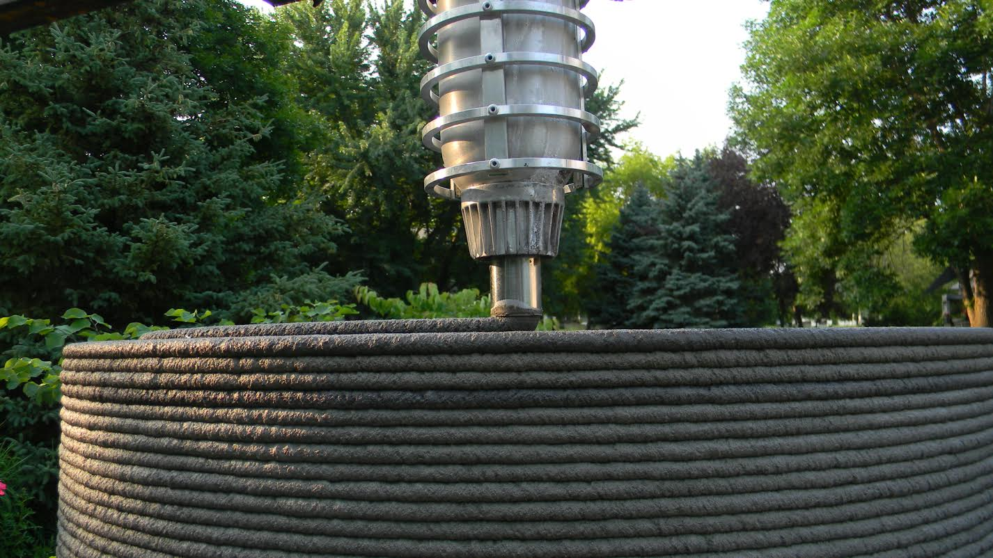
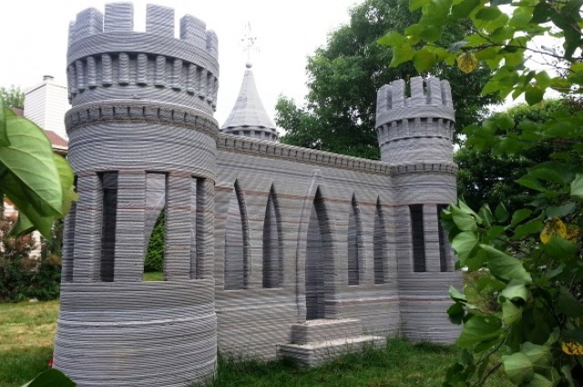
3D printing being applied to materials ranging from chocolate to cells or concrete
VІI scientific and practical seminar with international participation
"Economic security of the state and scientific and technological aspects of its provision"

Slide 5
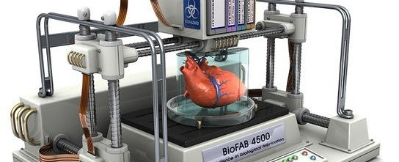
Social value
The first biological 3D-printer opens new perspectives in the field of recovery and implantation of organs and tissues.
Printing Industry of human organs is in its infancy, but scientists already have successful examples of the creation of human organs "from scratch".
VІI scientific and practical seminar with international participation
"Economic security of the state and scientific and technological aspects of its provision"

Slide 6
3D printing increases the energy efficiency
3D printing technology will enable manufacturers to easily produce goods to order, helping save money and minimize waste.
3D printing has potential for cost-effective, efficient and environmentally-friendly manufacturing.
Today, the 3D printing technology has spurred remarkable efforts in many manufacturing sectors; from building intricate aircraft and race car components.
VІI scientific and practical seminar with international participation
"Economic security of the state and scientific and technological aspects of its provision"

Slide 7
Is 3D Printing Eco-Friendly?
Can fabricate small batches of custom parts at the time of need (reducing inventory maintenance) near the point of purchase or consumption (reducing transportation pollution).
Makes more efficient use of raw materials: The 3D printing process places raw material only where it's needed (an ability referred to as "net shape manufacturing");
Has the ability to help designers develop parts and products for optimal performance, which could include reduced weight or longer product lives;
VІI scientific and practical seminar with international participation
"Economic security of the state and scientific and technological aspects of its provision"

Slide 8
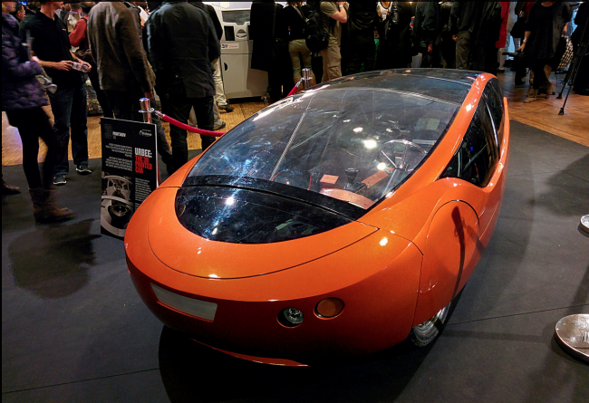
3-D Printed Electric Car
Urbee 2 is the first car made of printed the 3D-printer parts.
Three-wheeled machine is cheaper and consumes less fuel than any other car on the market, but the 23-hp engine (with batteries) allows it to develop incredible speed.
VІI scientific and practical seminar with international participation
"Economic security of the state and scientific and technological aspects of its provision"

Slide 9
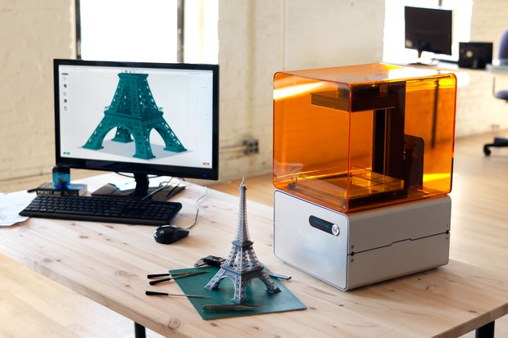
Prospects
With effects on energy use, waste reduction, customization, product availability, medicine, art, construction and sciences, 3D printing will change the manufacturing world as we know it.
VІI scientific and practical seminar with international participation
"Economic security of the state and scientific and technological aspects of its provision"

Slide 10
Thanks for your attention

