Slide 1

Nanobots in the context of innovative technologies
National Technical University of Ukraine "Kiev Polytechnic Institute"
HEAT POWER ENGINEERING FACULTY
VІI scientific and practical seminar with international participation
"Economic security of the state and scientific and technological aspects of its provision"
October 21-22, 2015, Kyiv, Ukraine
Student of 4th department
Group TM-22
Voronina Olga
Scientific Director
Varava I.A.

Slide 2
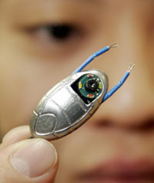
What is a nanobot?
Imagine an independent spacecraft. With own engine, capable independently and quickly moving in any direction, with "hands" manipulators which allow it to cooperate with the world, with a powerful computer which operates its actions, with system of connection which allows it to obtain the data and commands from "ground" and to cooperate with other same ships. In general, something turns out similar to American "shuttle". And now we make mental effort and this "shuttle" till the sizes of an albuminous molecule is reduced, keeping thus all its functions. In front of us is a nanobot.
VІI scientific and practical seminar with international participation
"Economic security of the state and scientific and technological aspects of its provision"
October 21-22, 2015, Kyiv, Ukraine

Slide 3
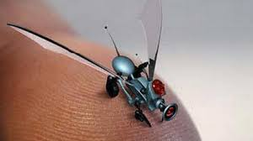
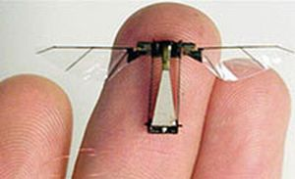
Nanorobot - it is the car is capable of accurately interact with nanoscale objects, or the ability to manipulate objects on the nanoscale.
Nanorobots, or nanobots - robots the size of a comparable molecule (less than 10 nm), has the function of movement, processing and transmission of information, the execution of programs.
VІI scientific and practical seminar with international participation
"Economic security of the state and scientific and technological aspects of its provision"
October 21-22, 2015, Kyiv, Ukraine

Slide 4
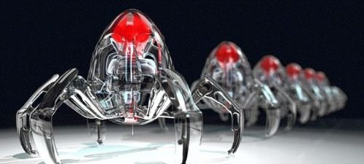
How to construct it?
A question is only in constructing of the first nanobot. Because it can make a copy of itself with the help of manipulators. Together they will construct two more. Then four. We will not have time to look back, as there will be already millions, and still after a while the air will be filled with them the same as now it is filled with various bacteria. What for? Clearly that when nanobots become a reality the world that we know will cease to exist.
VІI scientific and practical seminar with international participation
"Economic security of the state and scientific and technological aspects of its provision"
October 21-22, 2015, Kyiv, Ukraine

Slide 5
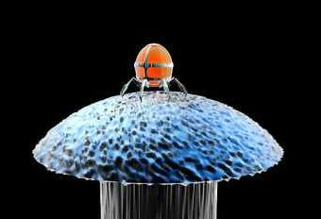
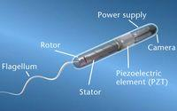
Already scientists created some primitive prototypes of molecular machines. For example, a sensor having a switch approximately 1.5 nanometers, capable to count individual molecules in chemical samples. Rice University recently demonstrated nanodevices for use in the regulation of chemical processes in modern cars.
VІI scientific and practical seminar with international participation
"Economic security of the state and scientific and technological aspects of its provision"
October 21-22, 2015, Kyiv, Ukraine

Slide 6
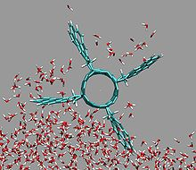
What tasks can perform nanobots?
In the future, nanorobots will be able to help a person get rid of many diseases because they can carry not only medicine, but also mini-tools directly to the internal organs and systems, which require treatment. I.e., "service" to have a more detailed address, than with treatment by conventional means, when the drugs are administered into the body orally, intramuscularly or intravenously. It is unknown which of them goes directly to the place which requires treatment, and which is dispersed in the body. Additionally, nanorobots moving precisely to the site of infection, reduce the risk of side effects that will benefit the health of the patient.
VІI scientific and practical seminar with international participation
"Economic security of the state and scientific and technological aspects of its provision"
October 21-22, 2015, Kyiv, Ukraine

Slide 7
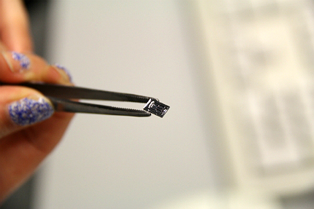
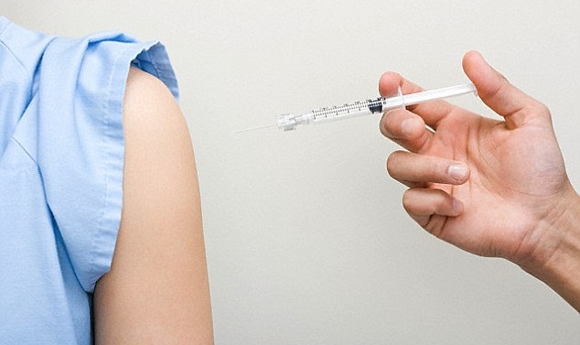
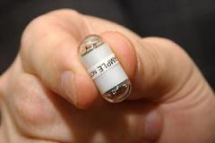
Imagine going to the doctor for treatment of constant cold. Instead of giving you a pill or a shot, the doctor sends you to a special medical team which implants a tiny robot in your blood. The robot recognizes the cause of your illness is sent to the appropriate system and provides a dose of medicine directly to the infected area.
VІI scientific and practical seminar with international participation
"Economic security of the state and scientific and technological aspects of its provision"
October 21-22, 2015, Kyiv, Ukraine

Slide 8
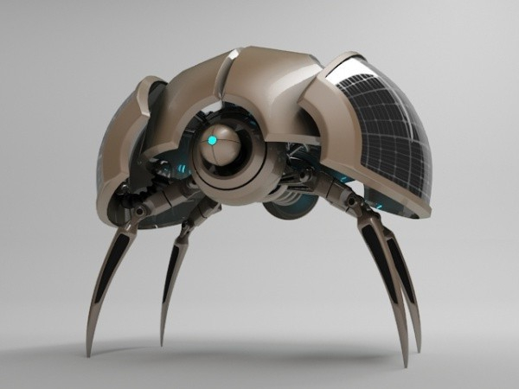
Now about sad
Nanobots can destroy in one second the population of any country. They can destroy only black or, on the contrary, only white. They can destroy only young people of 25 years. And everyone who is older than 50. All depends on the one who will operate with them. Nanobot is the computer which receives commands from the outside. At last they will receive real authority.
VІI scientific and practical seminar with international participation
"Economic security of the state and scientific and technological aspects of its provision"
October 21-22, 2015, Kyiv, Ukraine

Slide 9
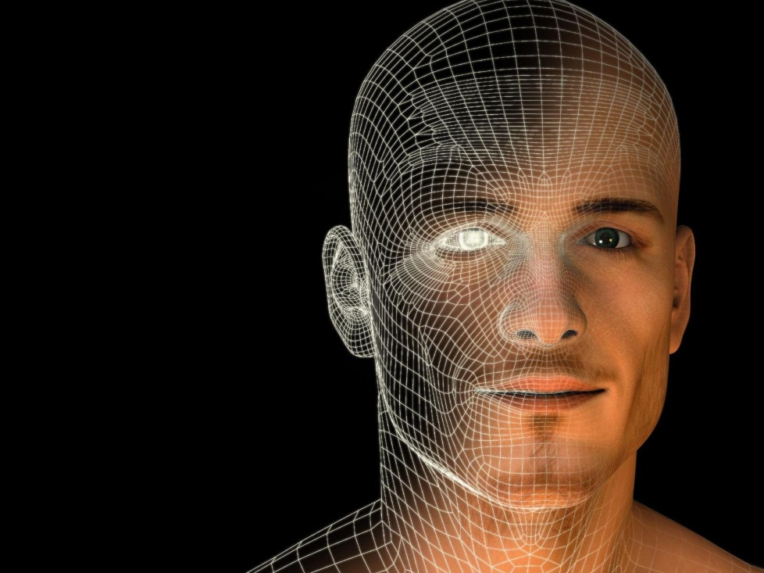
When will it happen?
The exact answer does not exist. From 15 up to 50 years, is more exact while nobody undertakes to predict. Process goes, more and more than research groups are involved in it, and more and more countries allocate money for scientific projects in this area. Its forms can be various.
VІI scientific and practical seminar with international participation
"Economic security of the state and scientific and technological aspects of its provision"
October 21-22, 2015, Kyiv, Ukraine

Slide 10
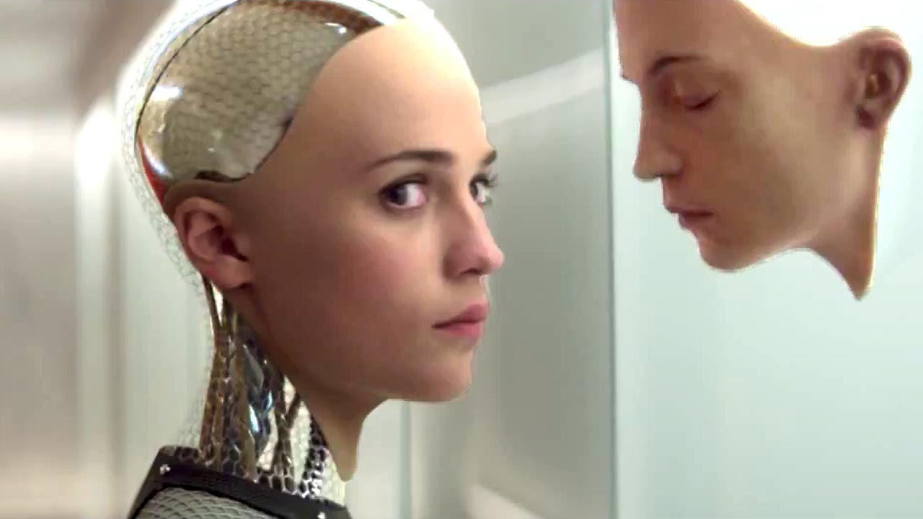
VІI scientific and practical seminar with international participation
"Economic security of the state and scientific and technological aspects of its provision"
October 21-22, 2015, Kyiv, Ukraine

Slide 11
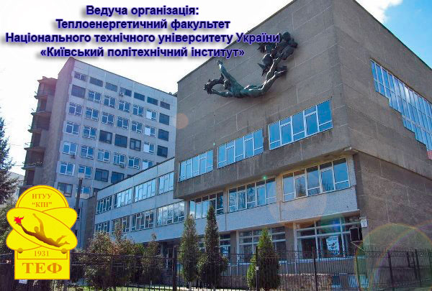
Thank you for attention!

