Slide 1


web page contents Verification against tags using data mining tool iknow
National Technical University of Ukraine
“Kyiv Polytechnic Institute”
Heat and Power Engineering Department
Automation of Design of Energy Processes and Systems
VІI scientific and practical seminar with international participation
"Economic security of the state and scientific and technological aspects of its provision"
October 21-22, 2015, Kyiv, Ukraine
Presented by Andrii Rak
4th grade student, group TI-21
Academic adviser I. Mykhailova

Slide 2
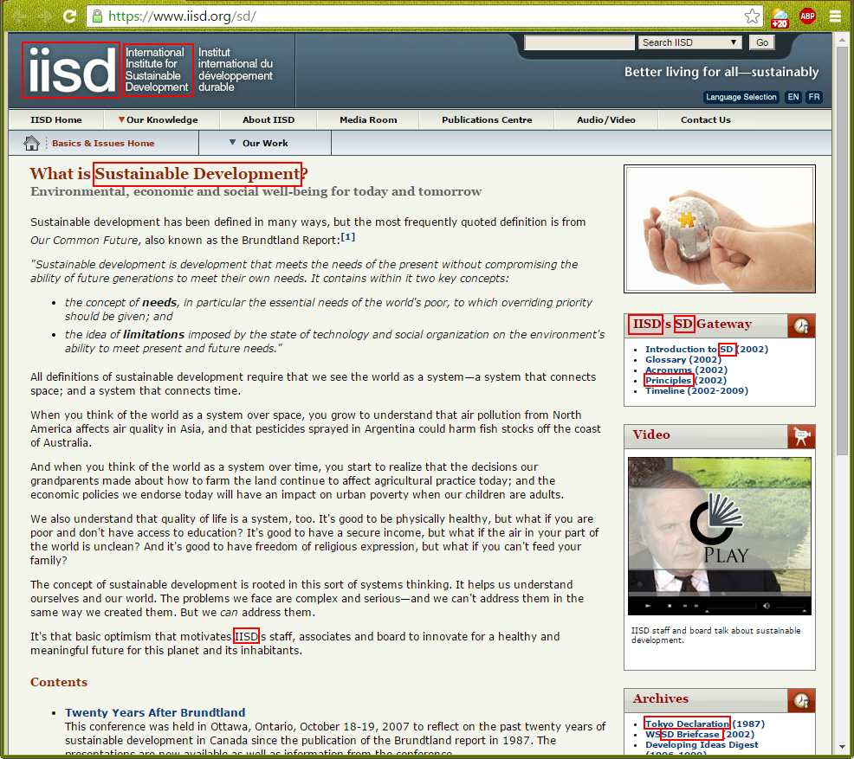
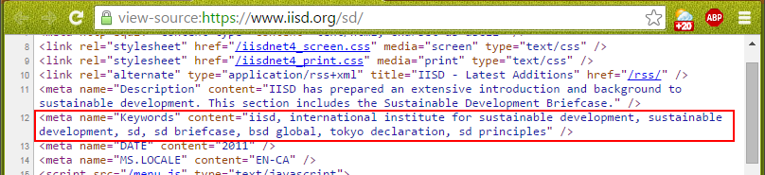
Purpose of the Application
Meta Keywords are a specific type of meta tag that appears in the HTML code of a Web page and helps tell search engines what the topic of the page is.
The most important thing to keep in mind when selecting meta keywords is to be sure that each keyword accurately reflects the content of your pages. Sometimes keywords don’t correspond with the contents. This application tells if it is so.

Slide 3
What is iknow?
iKnow is a generic text analysis technology
  Domain-independent
  Multi-purpose
  Multi-lingual
  Built into the core if DBMS Caché
  iKnow enables applications to analyze unstructured data
  Core functionality
    Identifies meaningful word groups (“entities”) in sentences based on semantics
  Entities and their context are the basis of all further analysis, such as:
    Queries within or across bodies of text
    Relevance calculations and summarization
    Matching against existing knowledge

Slide 4
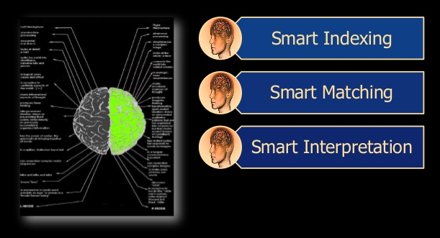
iKnow Services
  Smart indexing analyzes and transforms unstructured text into an understandable network of relationships and concepts without any need for pre-defined dictionaries, taxonomies, or ontologies. Smart indexing provides insight into what’s relevant, what’s related, and what’s representative within large volumes of unstructured text, without needing input of a search term.
  Smart indexing works with a number of different languages. It can also identify concepts (recurring patterns) within unstructured data that is not traditional text.
  Smart interpretation applies analytics and/or business rules to the results derived from smart indexing and smart matching.
  Smart matching links the results of smart indexing to existing knowledge specific to a domain, organization, or industry. Matching is based on meaningful concepts and their combinations, not just words, and includes exact, partial, and “scattered” matches.

Slide 5
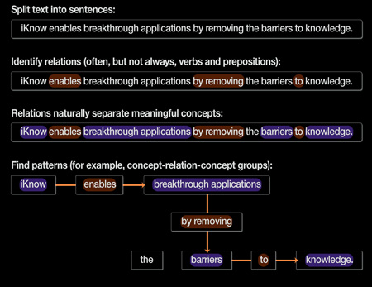
smart indexes

Slide 6
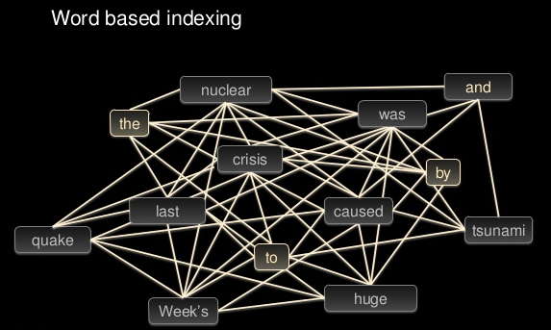
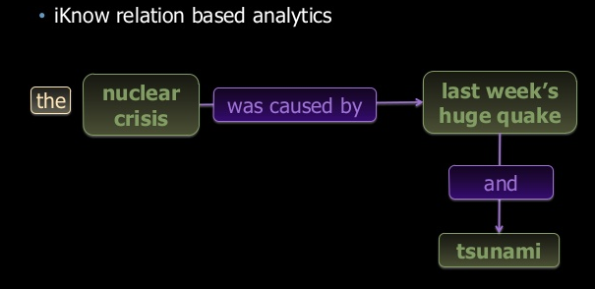
Text Analysis
Classic approach
iKnow approach

Slide 7
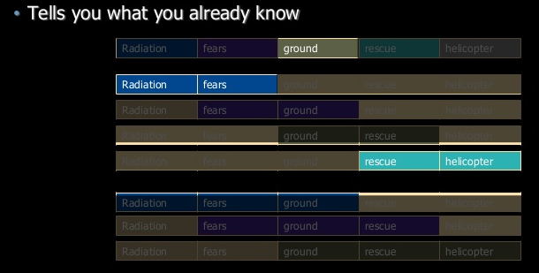
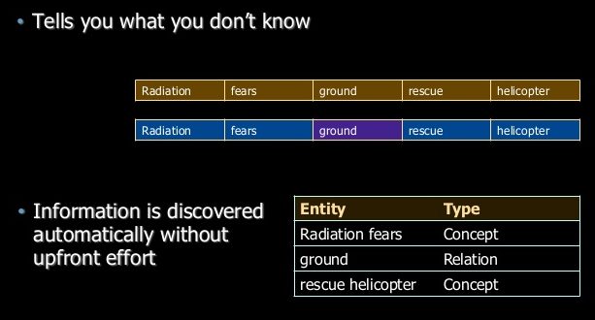
Text Analysis
Classic approach
iKnow approach

Slide 8
Smart matching
Matches the outcome of Smart Indexing with a dictionary supplied by user
  It is based on concepts, not just words
  Different match types
  For example: “stately old house”
Matching concept | Match type
Stately old house | Exact match
Stately old country house | Partial match
Old stately house | Exact scattered match
Old stately country house | Partial scattered match

Slide 9
Smart interpretation
Allows to use the outcome of Smart Matching for further processing
  Based on a context
  Compliance Score between a user defined rule and the Smart Matching Rule
  For example:
  Context: Local newspaper
  Rule: If (text contains “Bond Street” && “Trafalgar Square”)
  publish at page 3

Slide 10
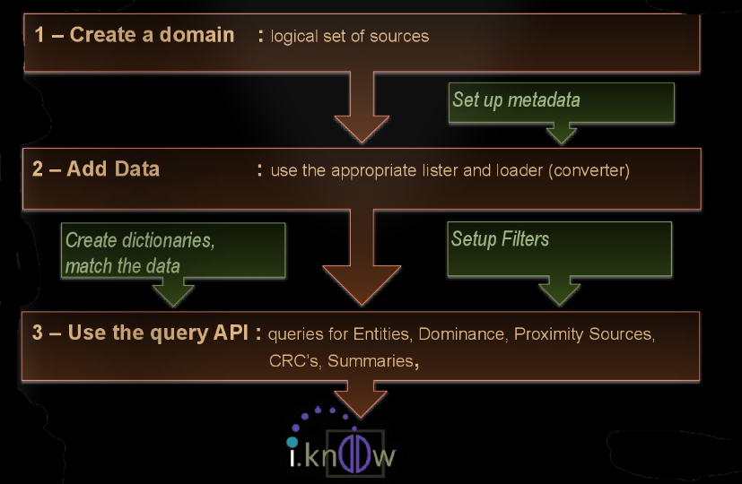
Implementation of iKnow

Slide 11
Sources
http://www.intersystems.com/our-products/cache/tech-guide/chapter-2
http://www.slideshare.net/InterSystemsBenelux/breakthrough-bi-analyzing-all-the-data
http://pt.slideshare.net/InterSystemsBenelux/intersystems-presentatie-making-sense-of-unstructured-data
http://www.slideshare.net/shvarov/iknow-healthcare-use-cases-meetup2014
http://www.wordstream.com/meta-keyword
https://www.iisd.org/sd

Slide 12
Thank you for your attention!

